Slide 1
Employee Turnover Prediction

Slide 2
Problem Statement
(wp)

Slide 3
Describe the Data

Slide 4
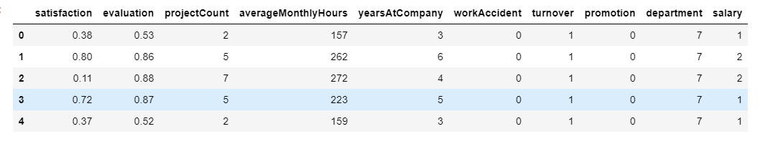
Data Looks Like

Slide 5
Data description (wp)

Slide 6
Predictors and Target
Describe predictors
Describe target

Slide 7
Talk about target column “left”
0 indicates – employee did not leave
1 indicates – employee left the company

Slide 8
Data Preprocessing
Renaming the columns : Sales to department
Change categorical to numeric and why did you do it? : Salary mapping and department

Slide 9
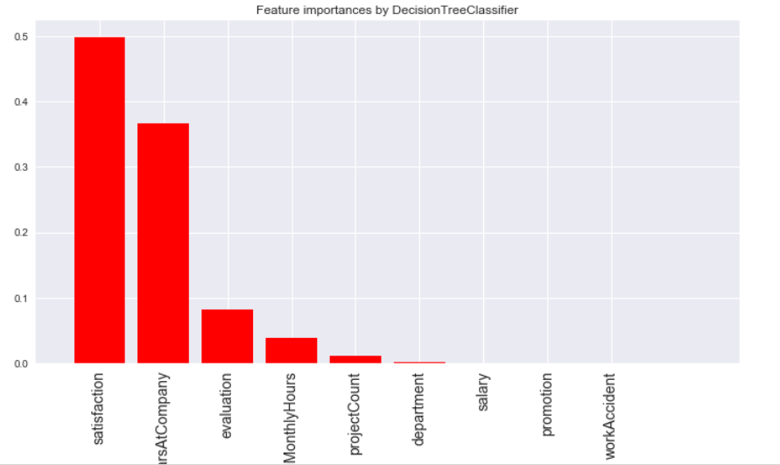
Feature Ranking

Slide 10
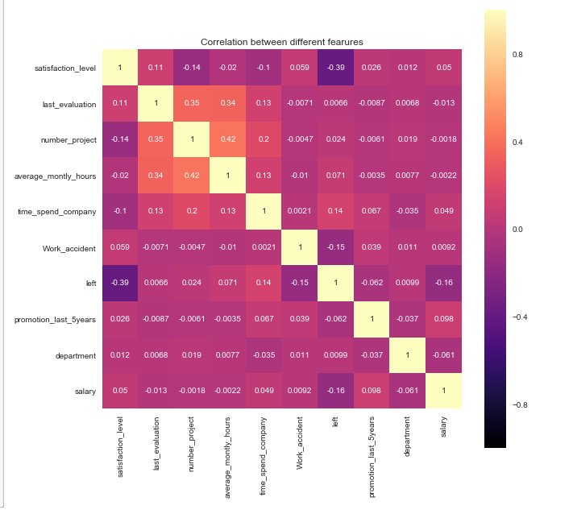
Correlation

Slide 11
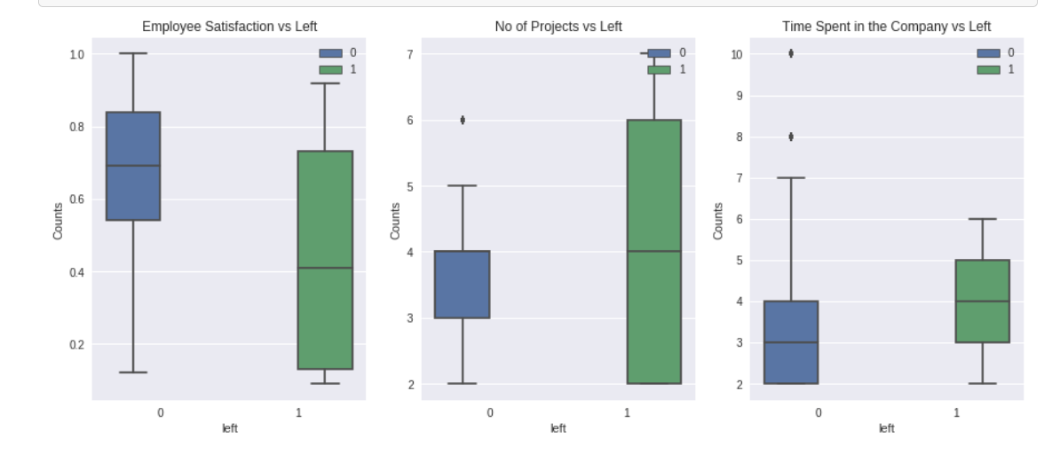

Slide 12
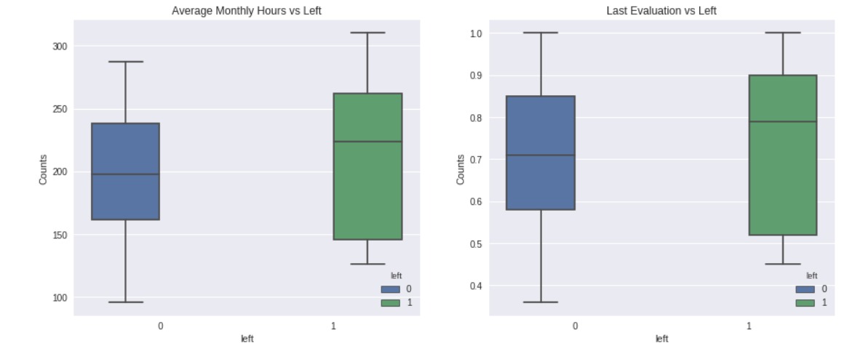

Slide 13
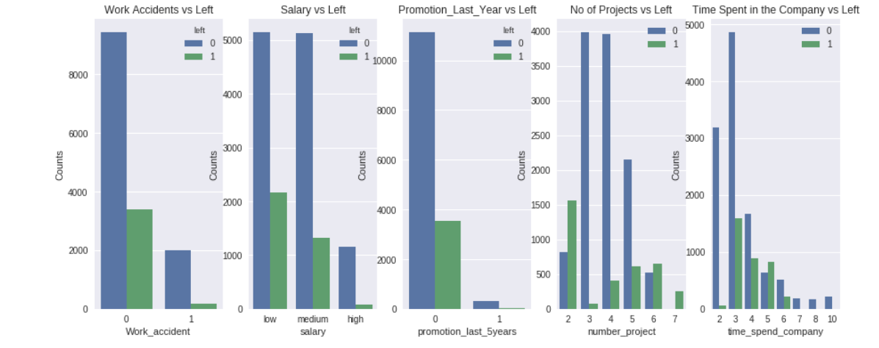

Slide 14
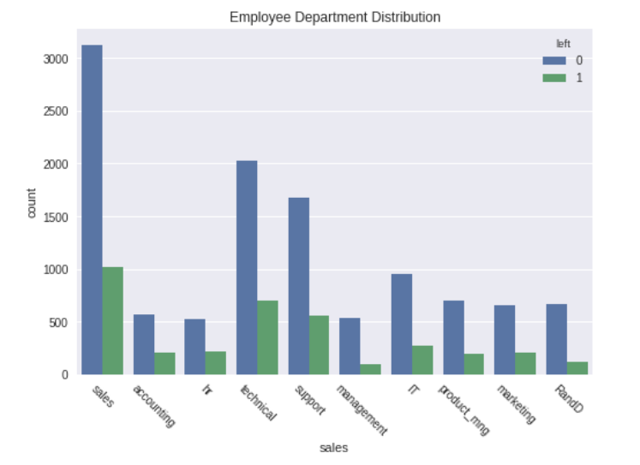

Slide 15
Regularization

Slide 16
Models
With and without cross validation
Precision
Recall
Accuracy
Confusion matrix

Slide 17
Inferences

Slide 18
Retention Strategy

Slide 19
Future Scope

